Slide 1
Install Eclipse on Mac pro

Slide 2
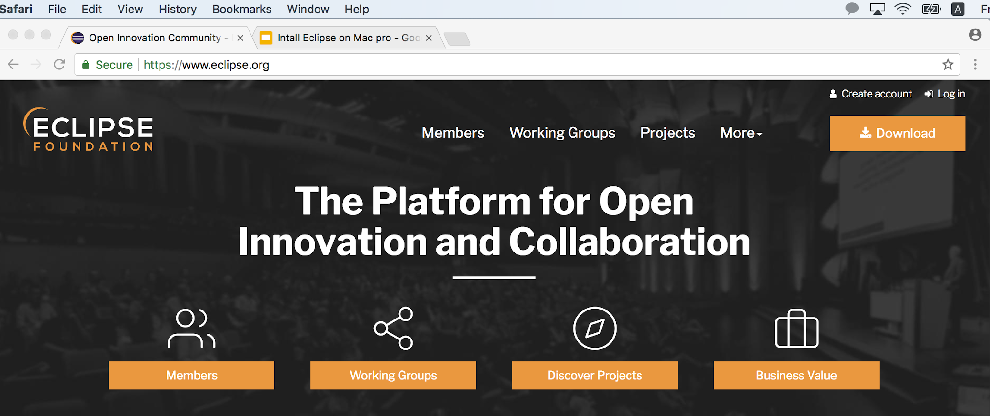
Visit Eclipse homepage: https://www.eclipse.org/
Click Download!

Slide 3
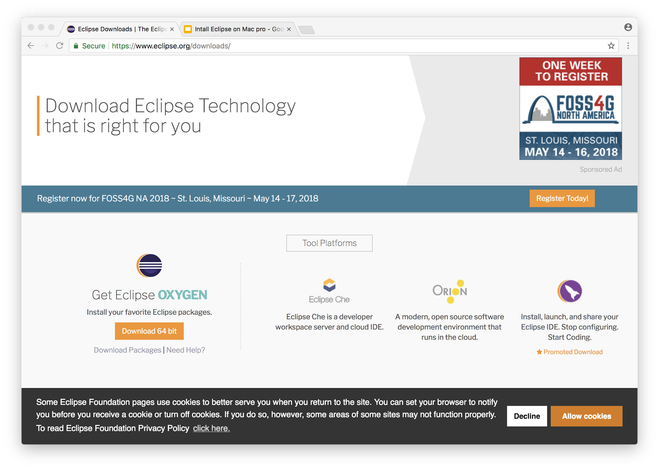
Download 64 bit

Slide 4
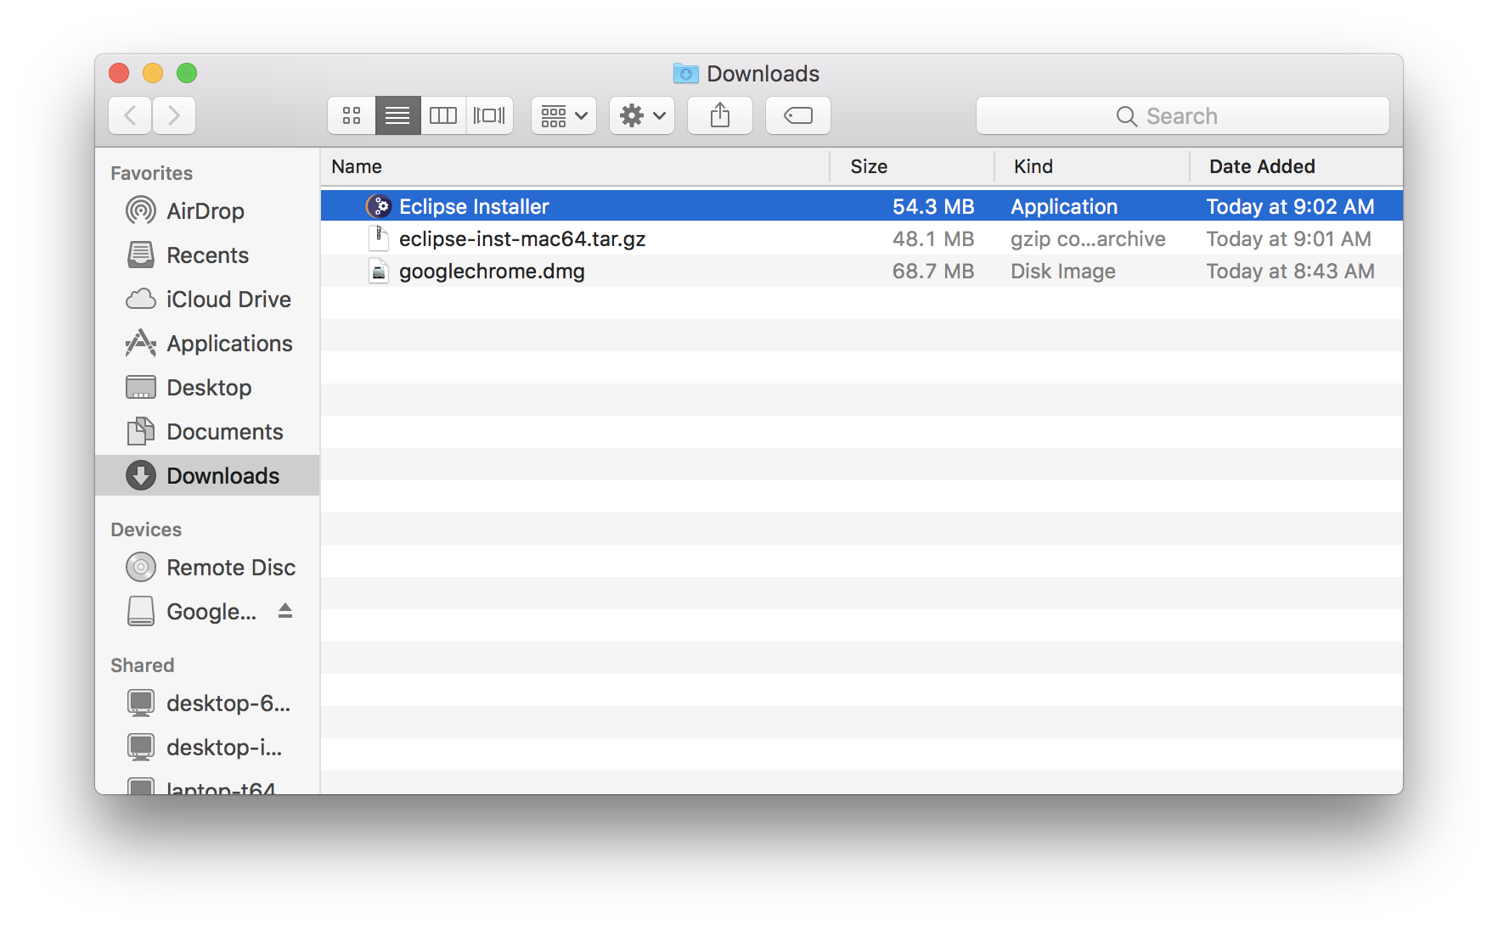
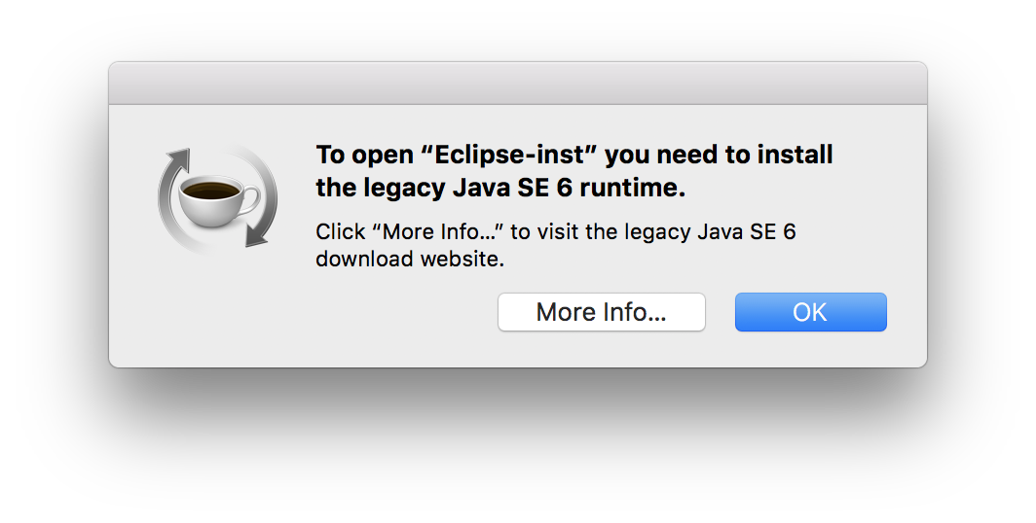
Execute Eclipse Installer
If you face this message, download java (JDK for Mac OS) here and install it first. http://www.oracle.com/technetwork/java/javase/downloads/jdk10-downloads-4416644.html

Slide 5
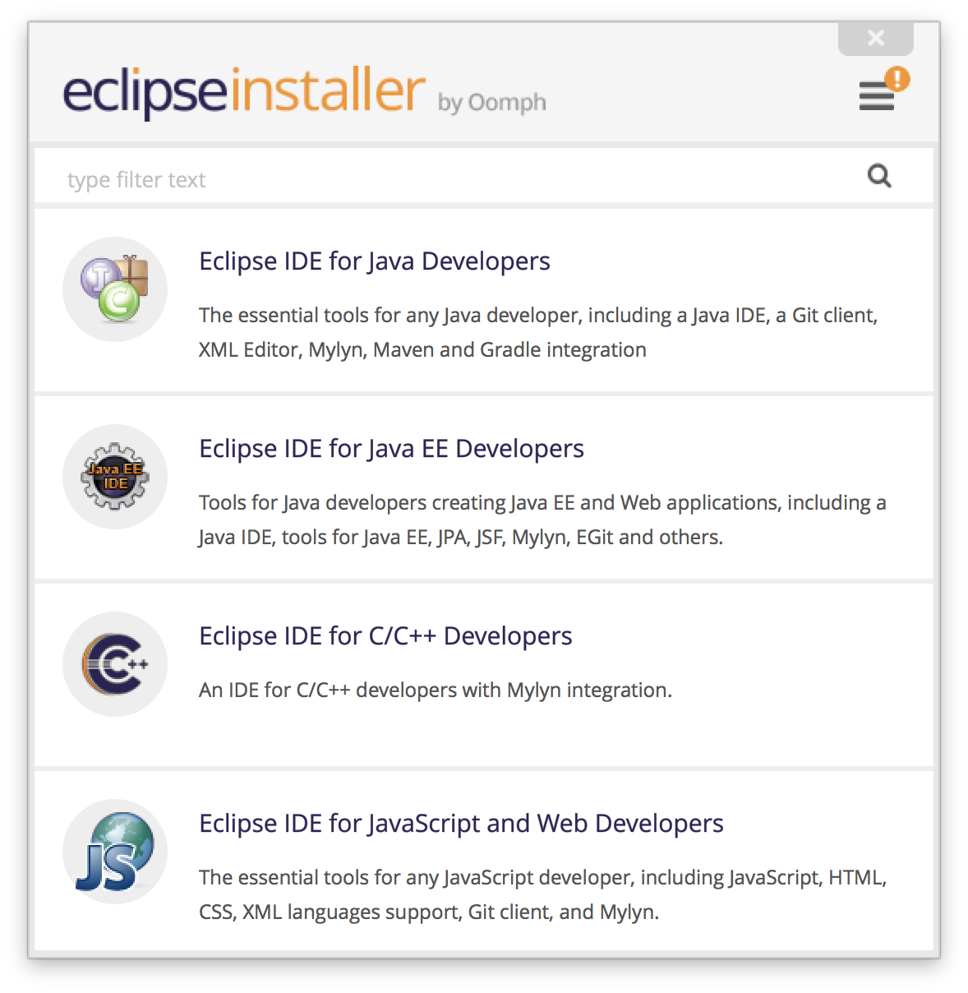
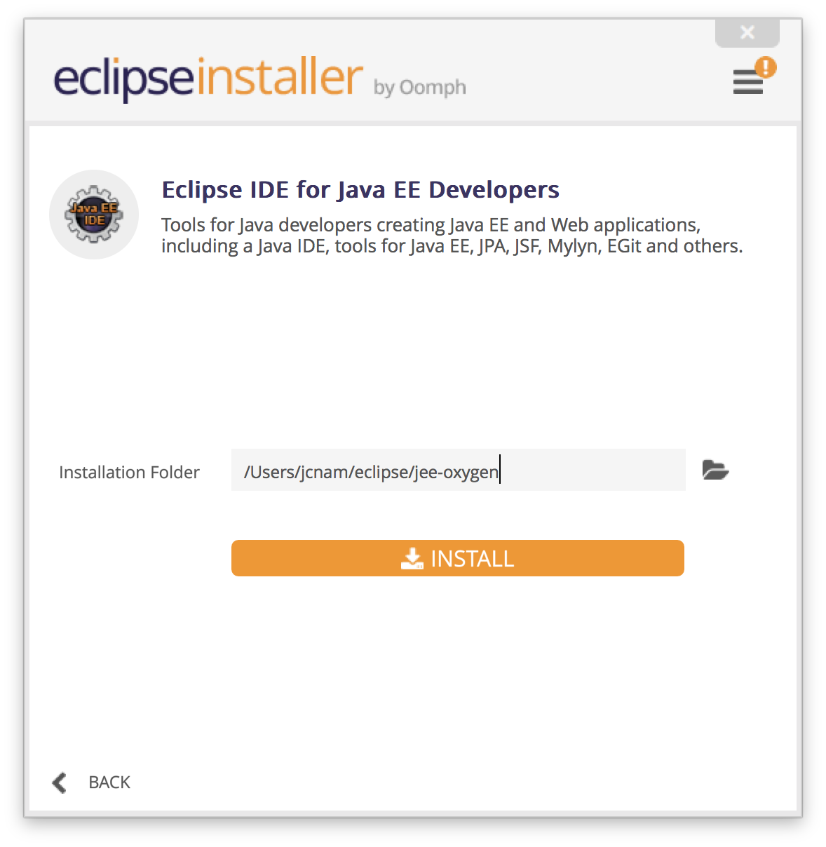
Accept licence-related steps.

Slide 6
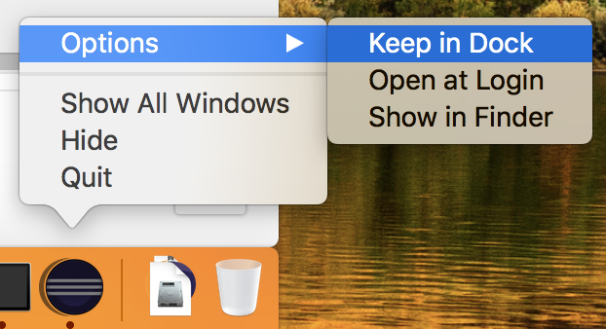
Launch
Click Launch button
Keep Eclipse icon in Dock for your frequent use

